Slide 1
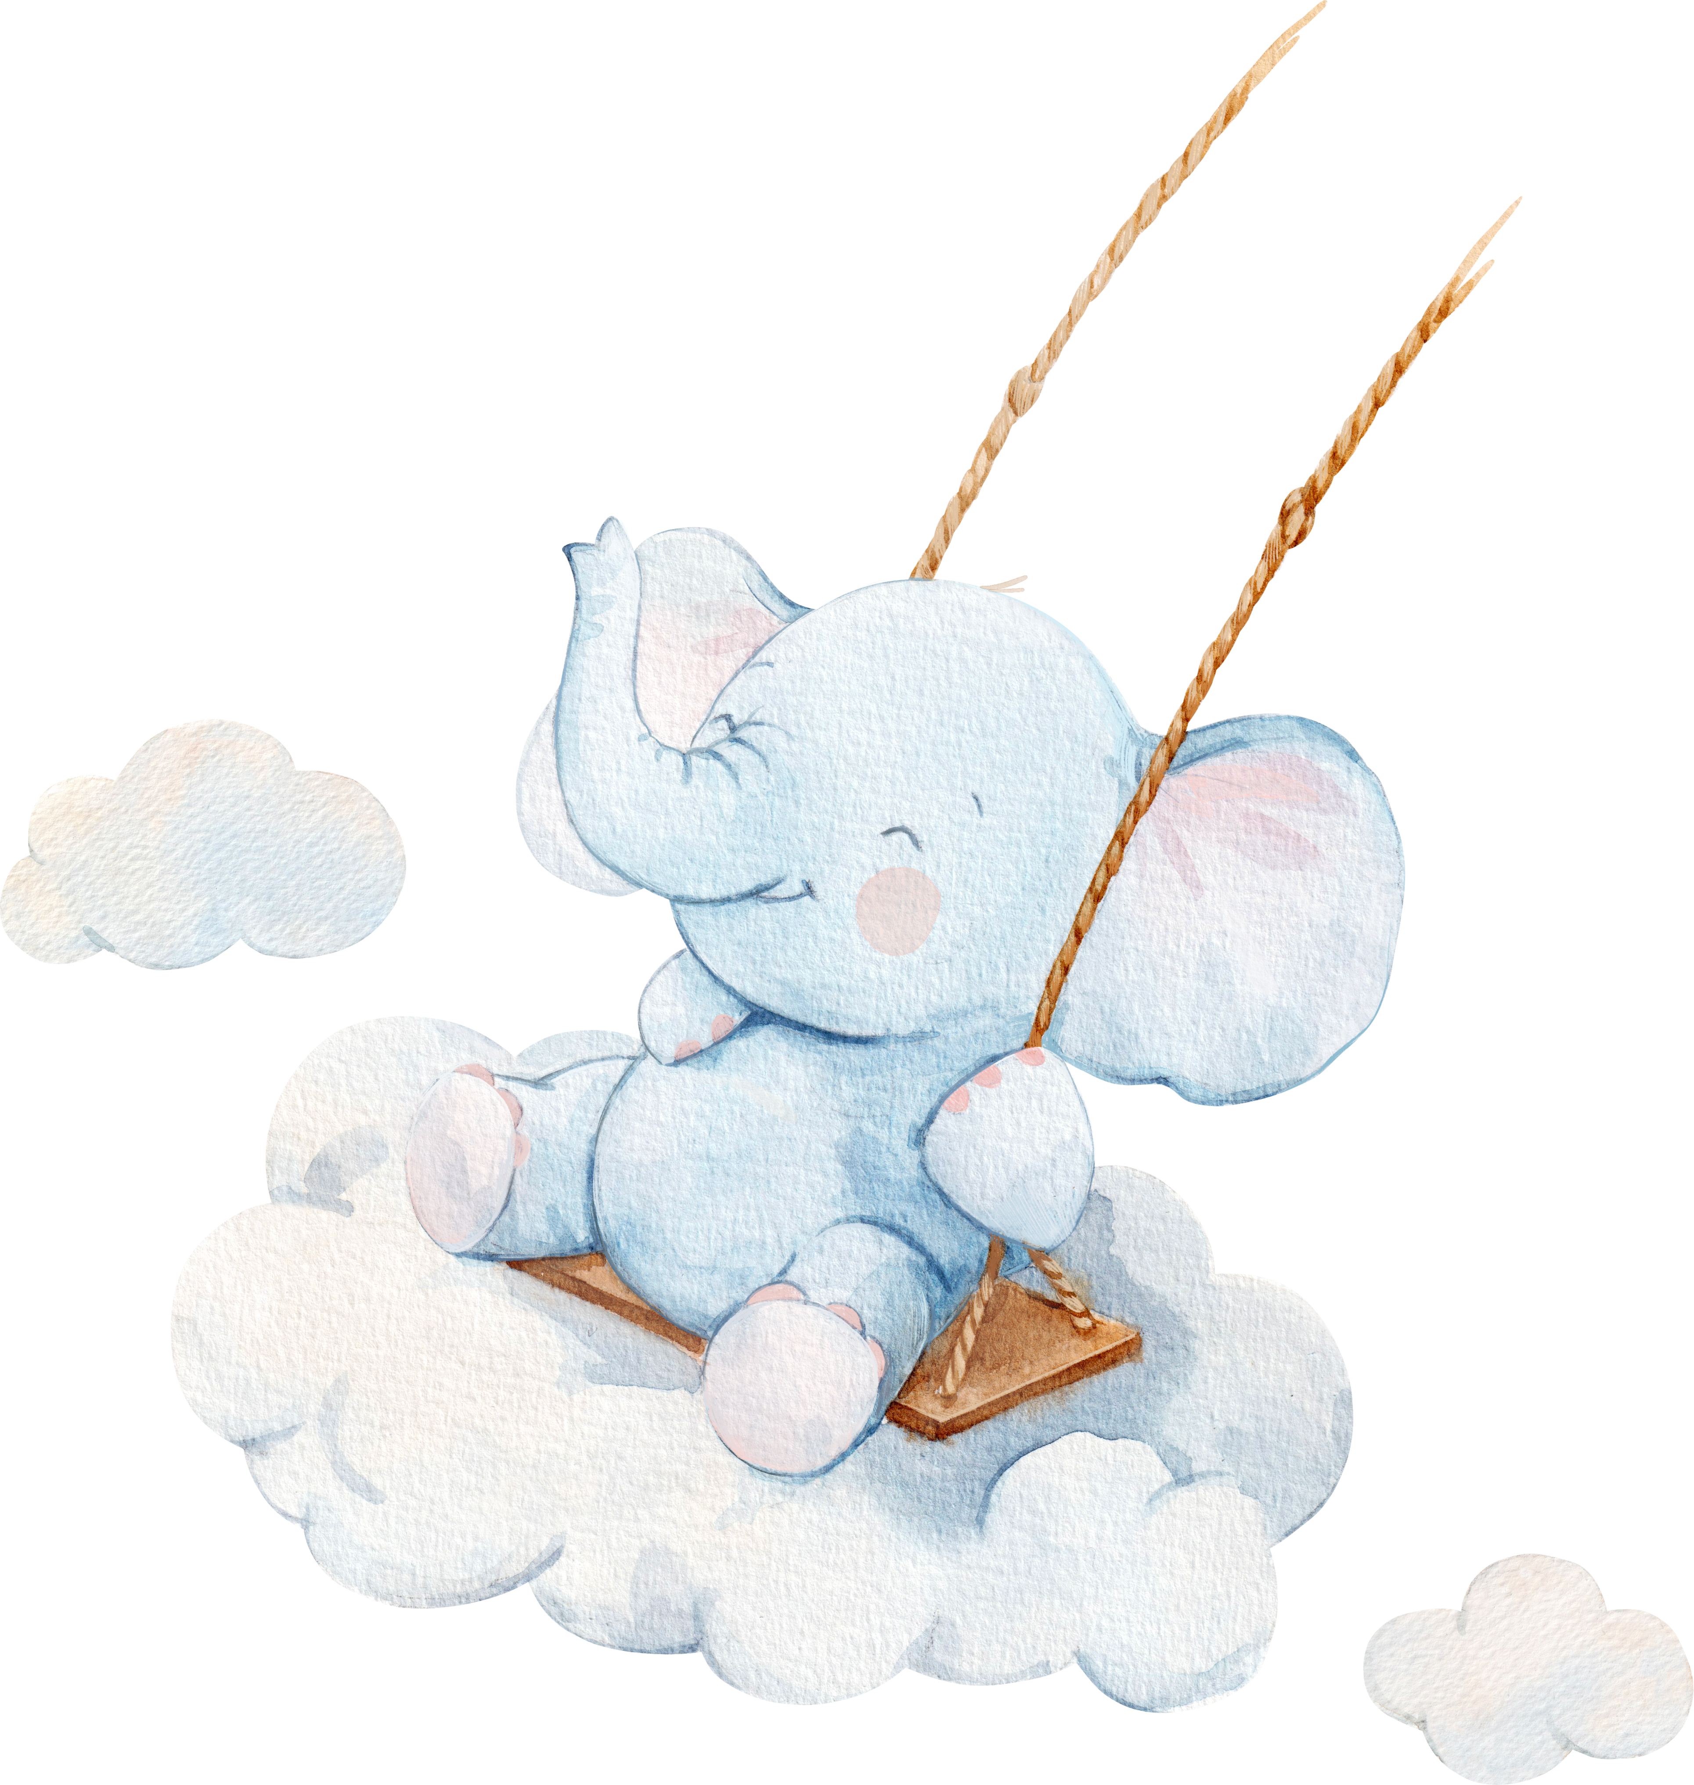


It's a Boy!
WELCOME
BABY
03.10.2030

